Slide 1
基础算法(九) -- 排序十讲
bubble sort, insertion sort, selection sort, shell sort,
quick sort, merge sort, heap sort
counting sort, bucket sort, radix sort *pancake sort
215. Kth Largest Element in an Array
148. Sort List & count of inversion pairs
75. Sort Colors
451. Sort Characters By Frequency
164. Maximum Gap
你们的好朋友Eddie

Slide 2

那些考？那些不考？
https://www.youtube.com/watch?v=S5yuwp3-r20&ab_channel=LeetCode%E5%8A%9B%E6%89%A3
常考的:
merge sort,
quick sort (quick select)
bucket sort
counting sort
heap sort
少考的:
pancake sort
不考的:
bubble sort,
selection sort,
insertion sort,
shell sort
radix sort

Slide 3
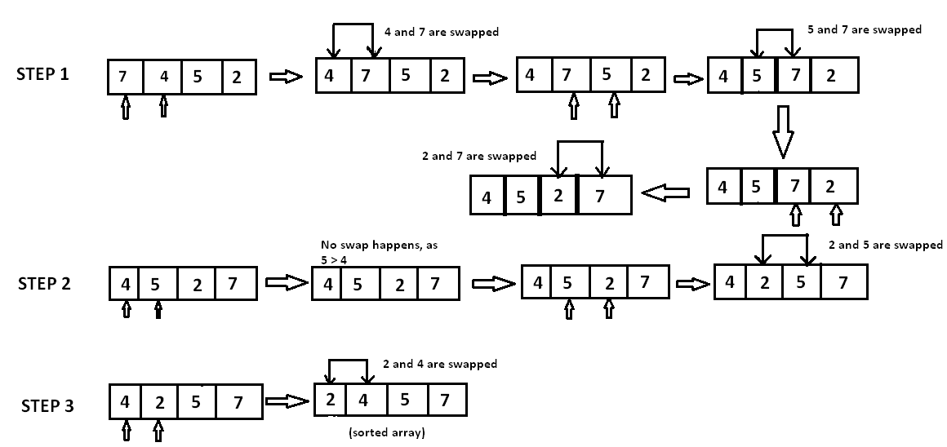
bubble sort
private void bubbleSort(int arr[]) {
int N = arr.length;
for (int i = 0; i < N - 1; i++)
for (int j = 0; j < N - 1 - i; j++)
if (arr[j] > arr[j + 1])
swap(arr, j, j + 1);
}
private void swap(int[] array, int i, int j){
int tmp = array[i];
array[i] = array[j];
array[j] = tmp;
}
time complexity: O(n^2)
space complexity: constant O(1)

Slide 4
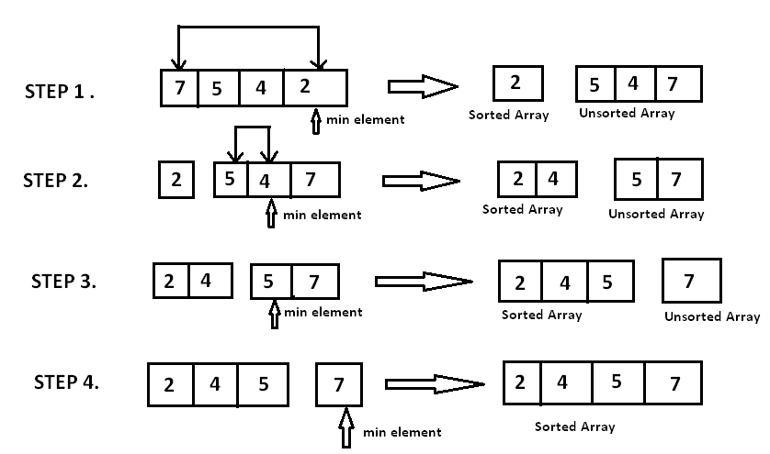
selection sort
public int[] selectionSort(int[] array) {
if (array == null || array.length <= 1) {
return array;
}
for (int i = 0; i < array.length - 1; i++) {
int minIndex = i;
for (int j = i + 1; j < array.length; j++) {
If (array[j] < array[minIndex]) {
minIndex = j;
}
}
swap(array, i, minIndex);
}
return array;
}
private void swap(int[] array, int i, int j) {
int tmp = array[i];
array[i] = array[j];
array[j] = tmp;
}
// time complexity: O(n^2)
// space complexity: constant

Slide 5
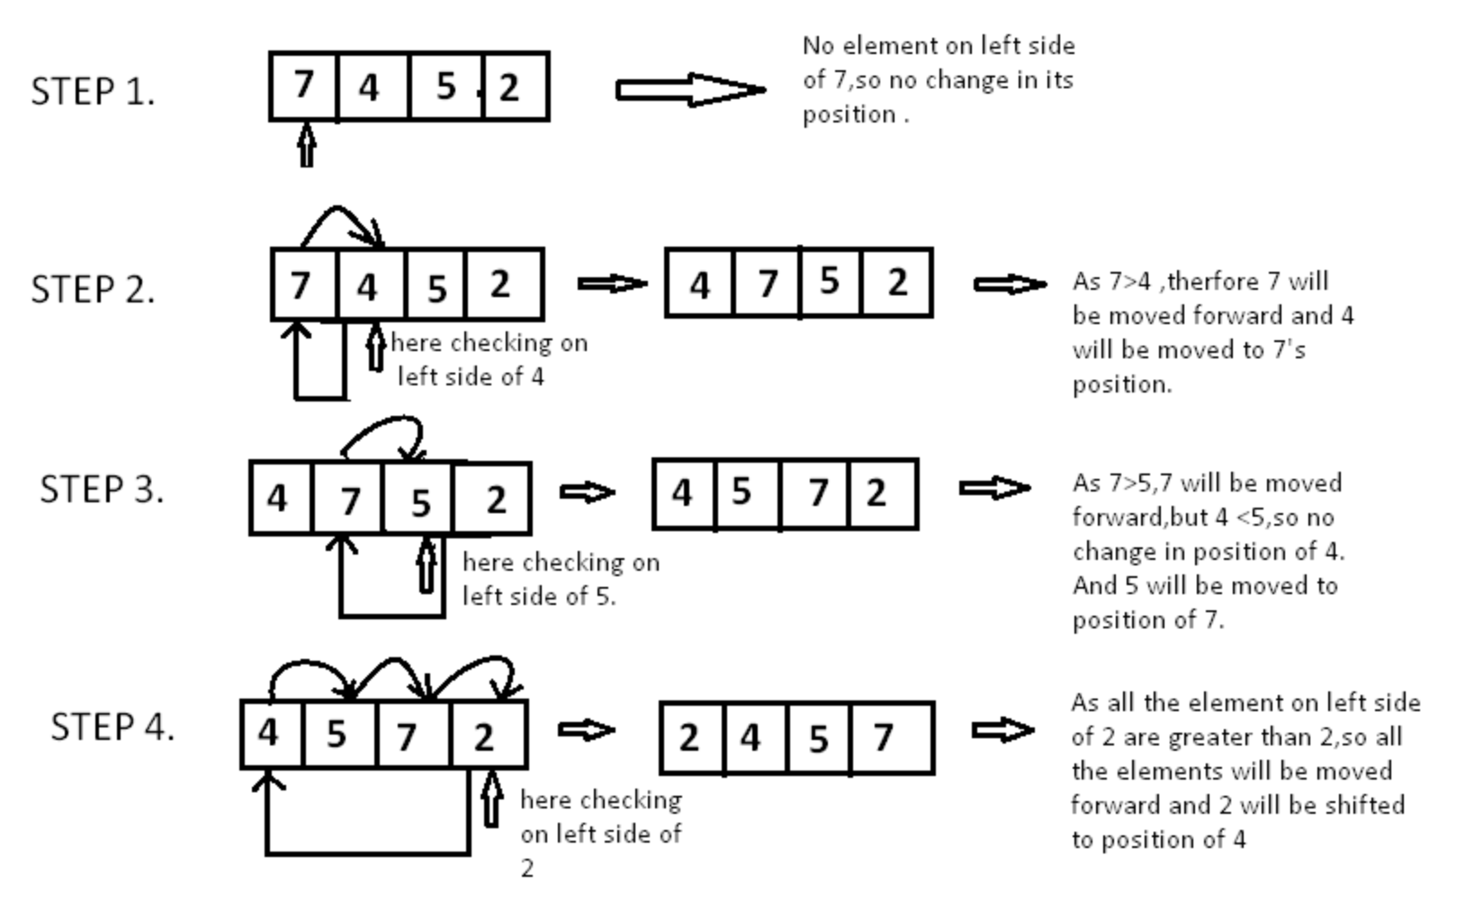
insertion Sort
private void insertionSort(int[] nums) {
int N = nums.length;
for (int i = 0; i < N; i++) {
int tmp = nums[i];
int j = i;
while (j > 0 && nums[j - 1] > tmp) {
//往后推，给更小的留位置
nums[j] = nums[j - 1];
j--;
}
nums[j] = tmp; //4到了前面
}
}
time complexity: O(n^2)
space complexity: constant O(1)

Slide 6
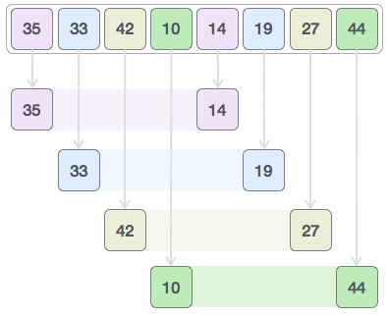
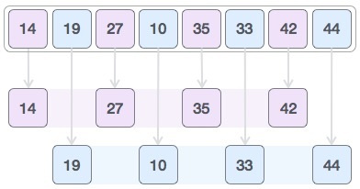
shell sort
public void shellSort(int arr[]) {
int N = arr.length;
for (int gap = N / 2; gap > 0; gap /= 2)
for (int i = gap; i < N; i += 1) {
int temp = arr[i];
int j = i;
while (arr[j - gap] > temp) {
arr[j] = arr[j - gap];
j -= gap;
}
arr[j] = temp;
}
}
Time Complexity: Time complexity of above implementation of shellsort is O(n2)..
Shell sort is based on the Insertion sorting algorithm, and it belongs to the group of very efficient algorithms. In general, the algorithm breaks an original set into smaller subsets and then each of those is sorted using Insertion sort.

Slide 7
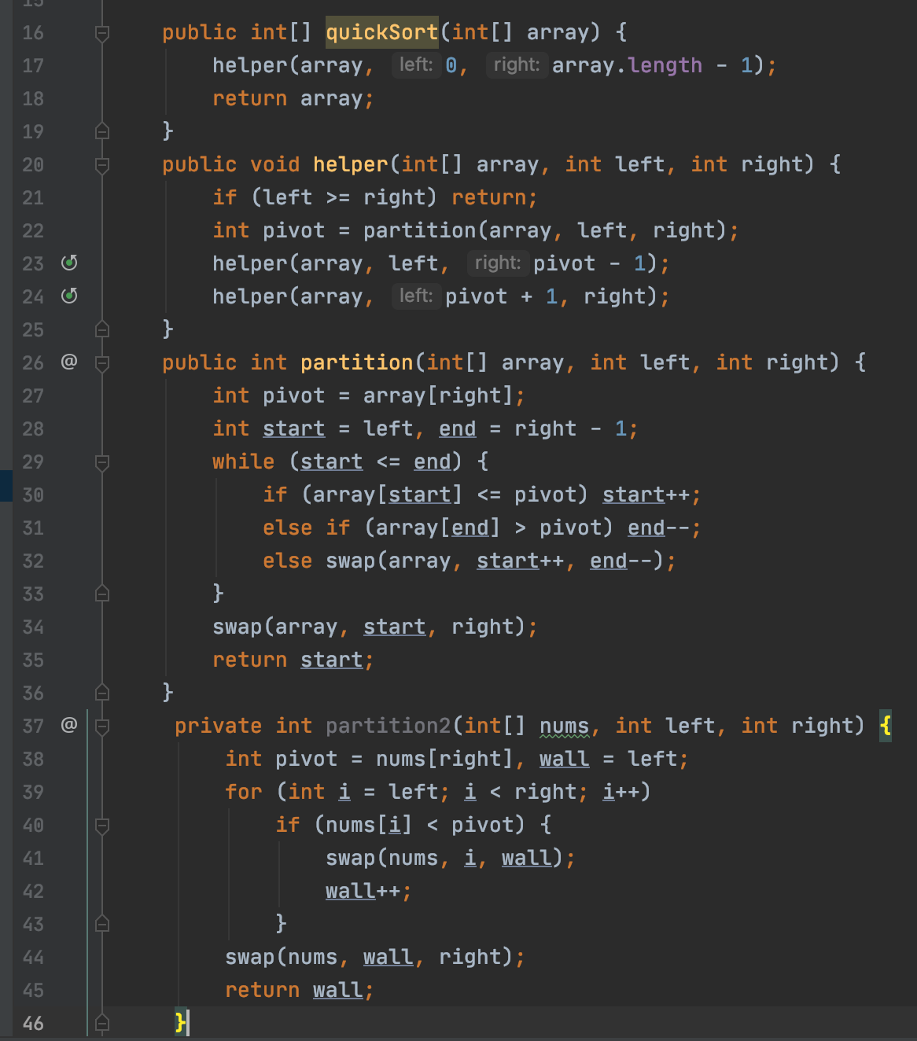
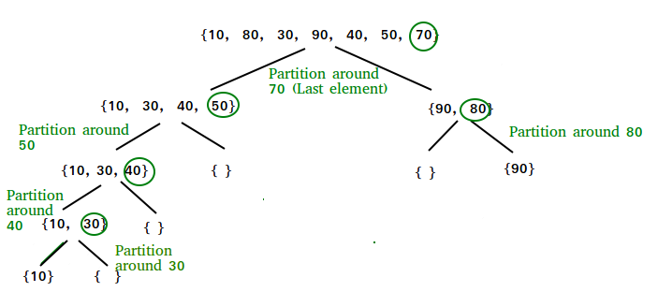
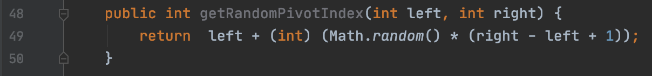
quick sort
Mathematical analysis of quicksort shows that, on average, the algorithm takes O(n log n) comparisons to sort n items. In the worst case, it makes O(n²) comparisons, though this behavior is rare.
我们可以使用
shuffle the array first before sort
pick pivot randomly

Slide 8
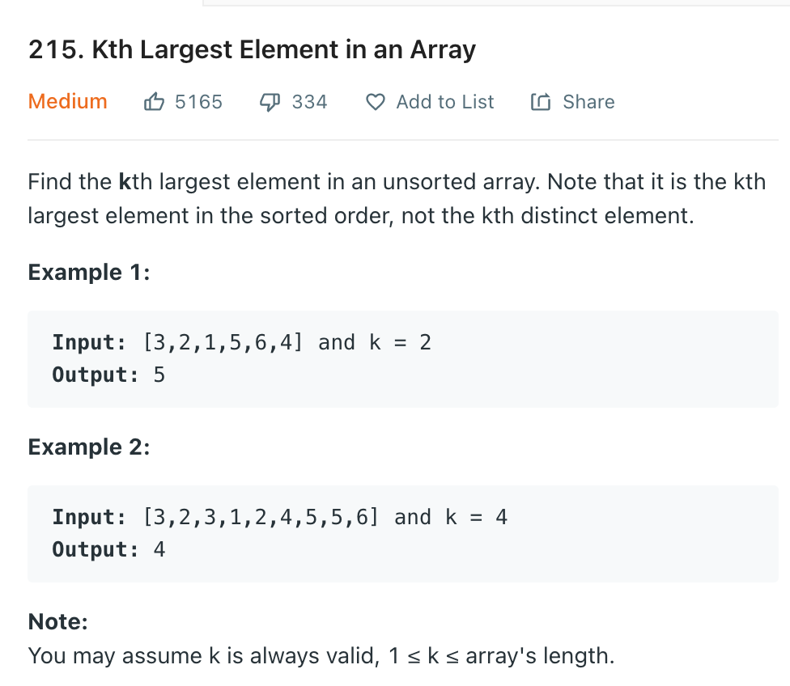
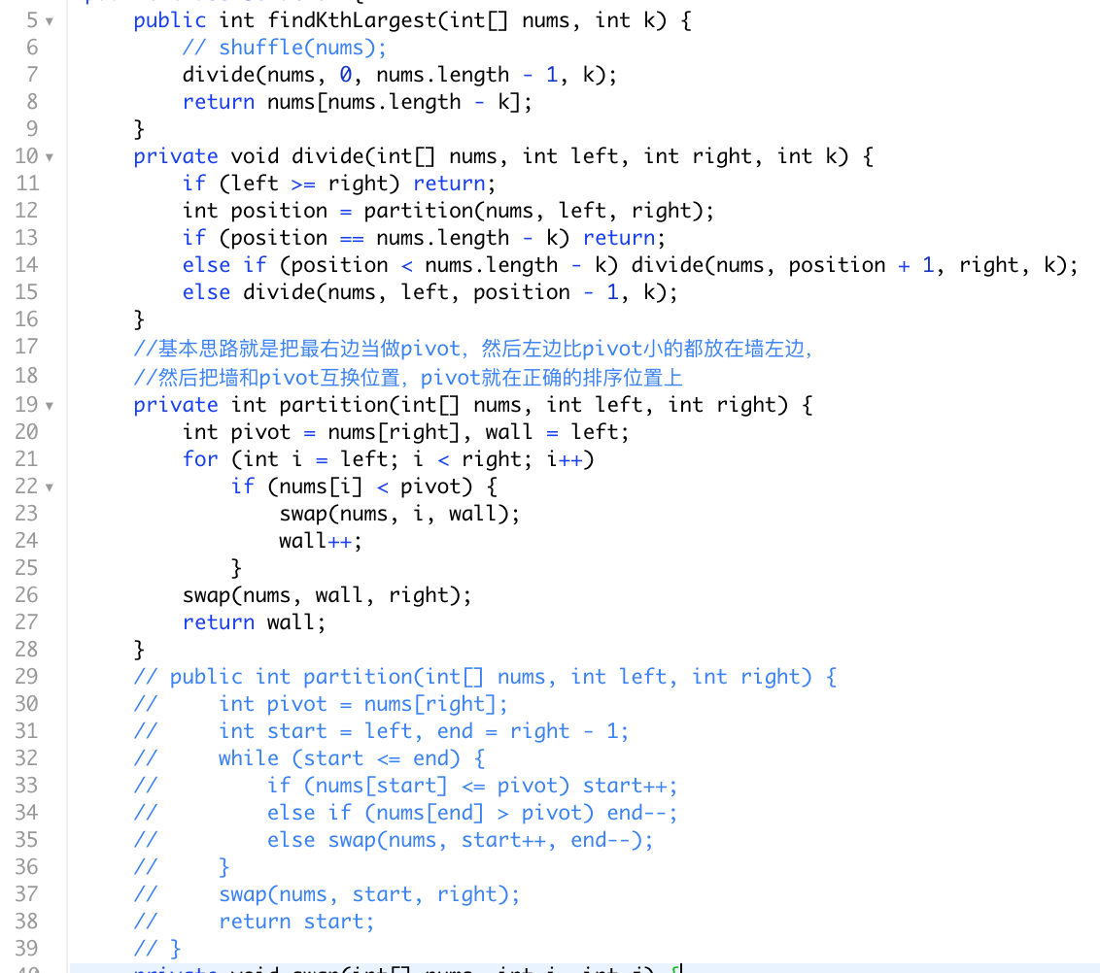
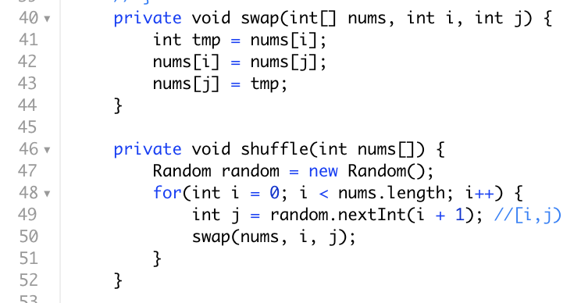
Avg T(n) = O(n)
Quickselect is a selection algorithm to find the k-th smallest element in an unordered list. It is related to the quick sort sorting algorithm.

Slide 9
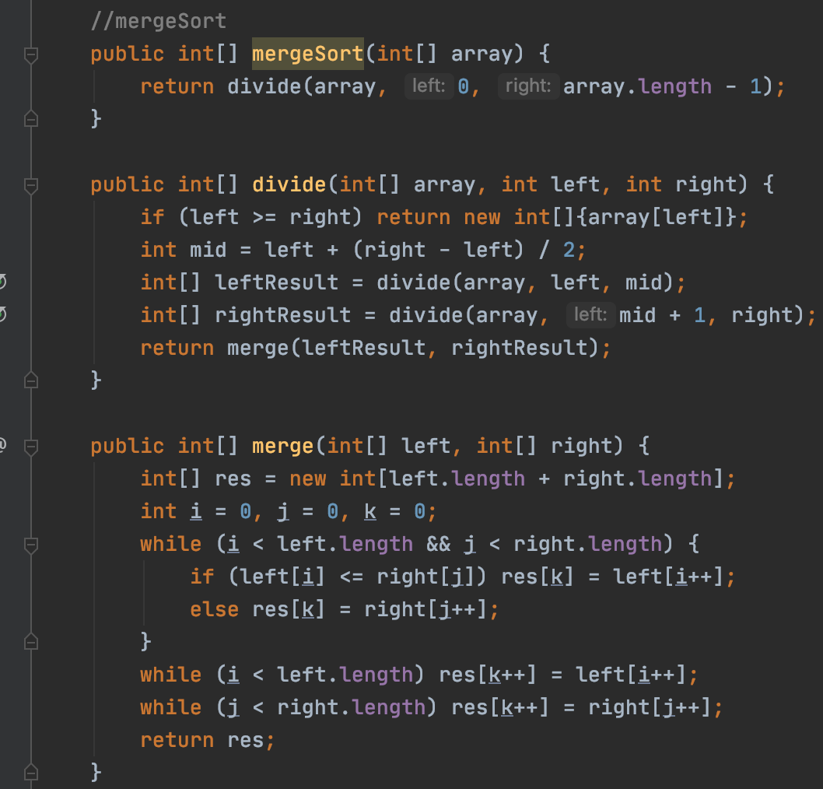

merge sort
O(n) = O(nlogn)

Slide 10
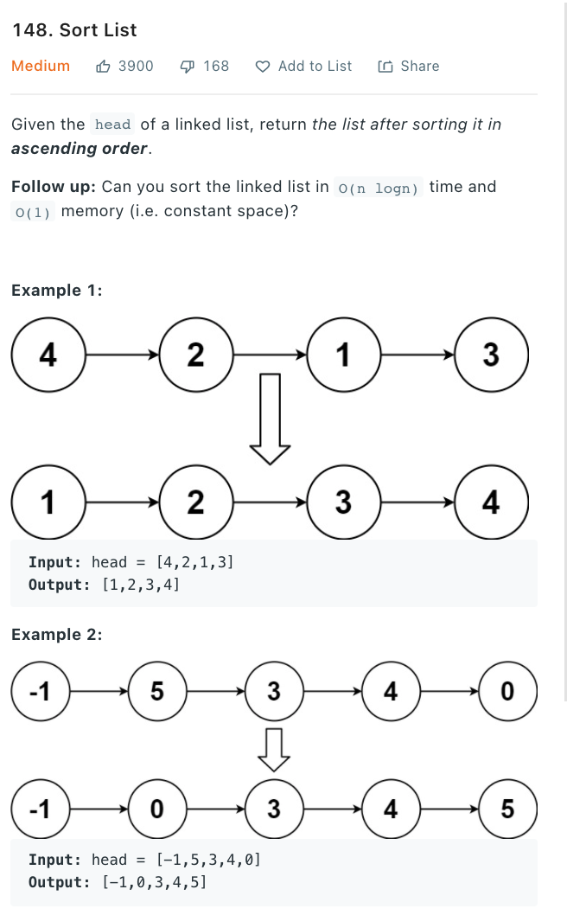
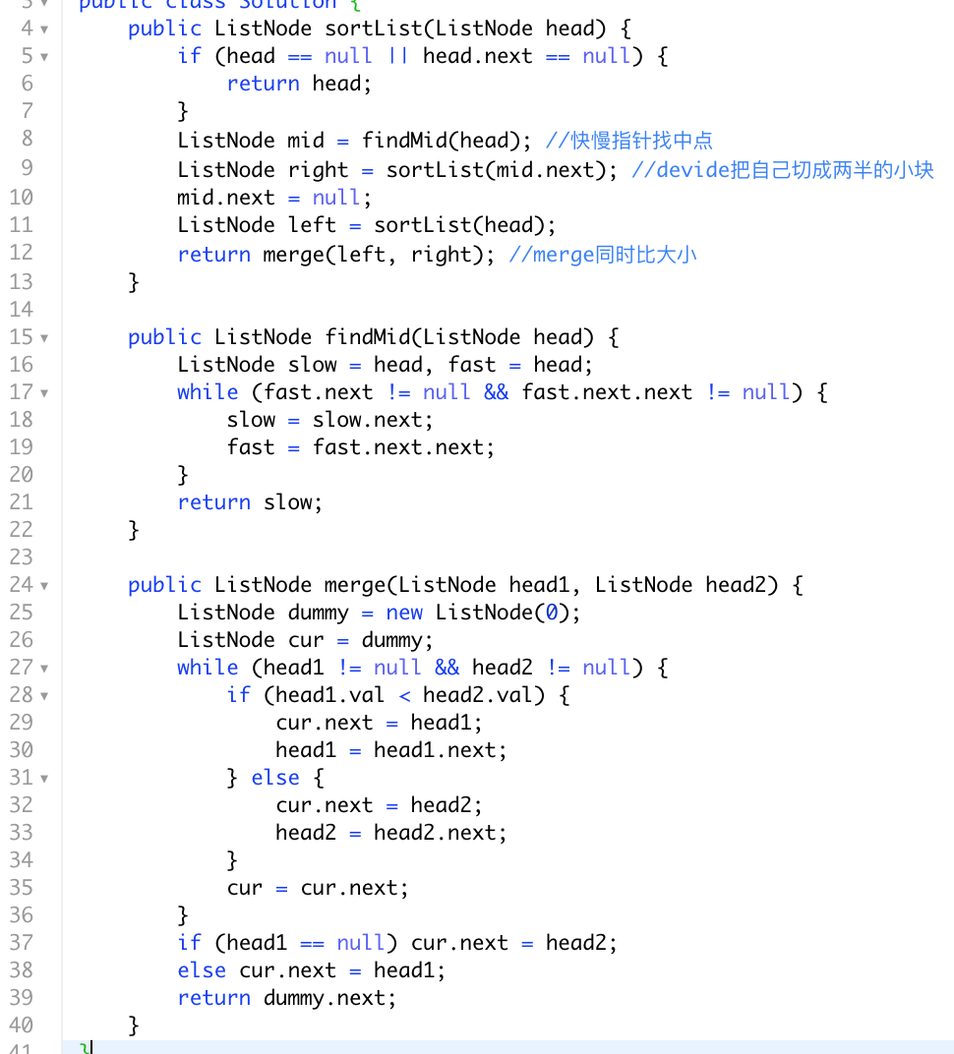
array sort
变成
list sort
核心不变，直接上模板

Slide 11
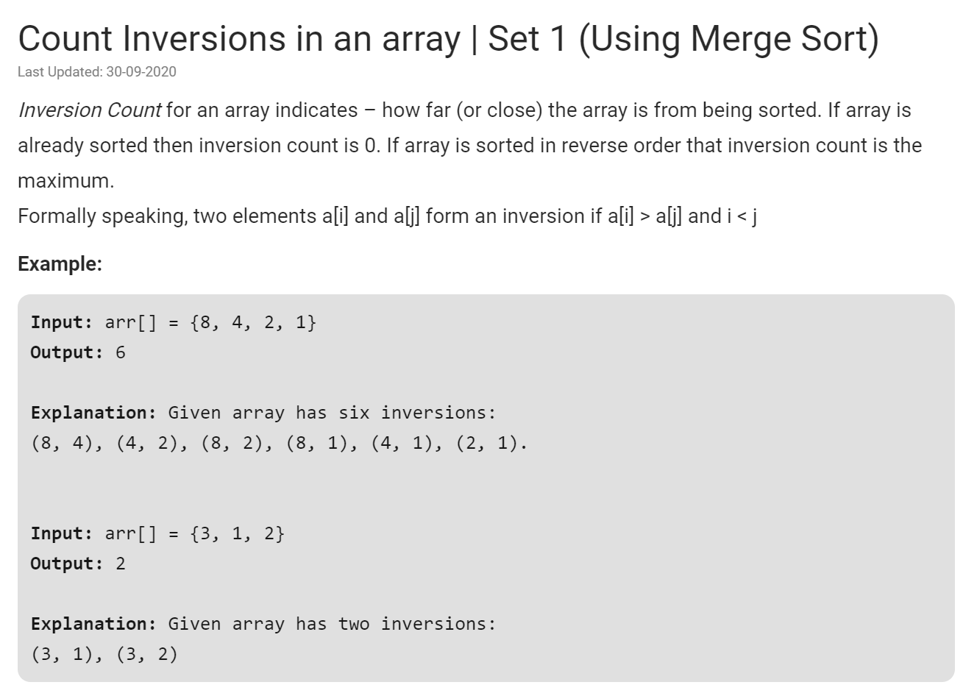

Slide 12
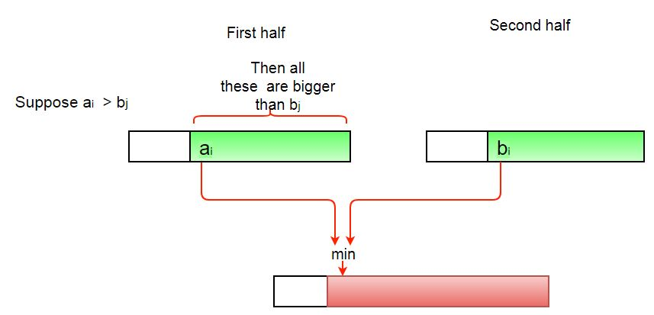
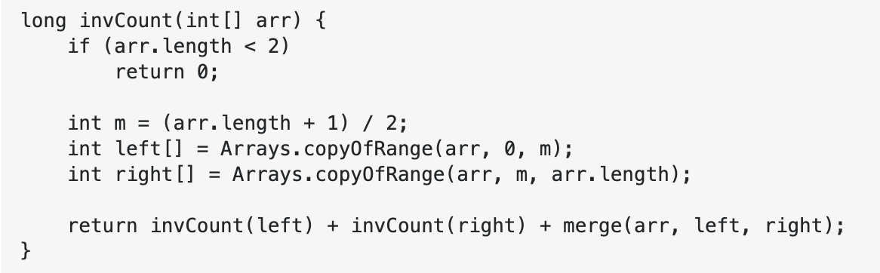
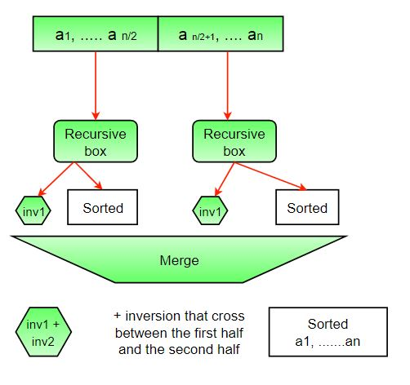
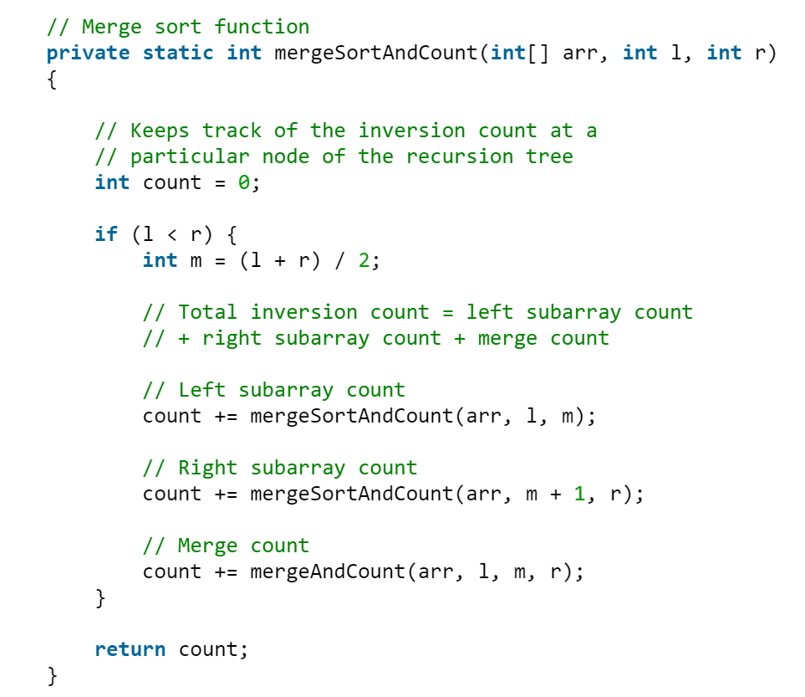
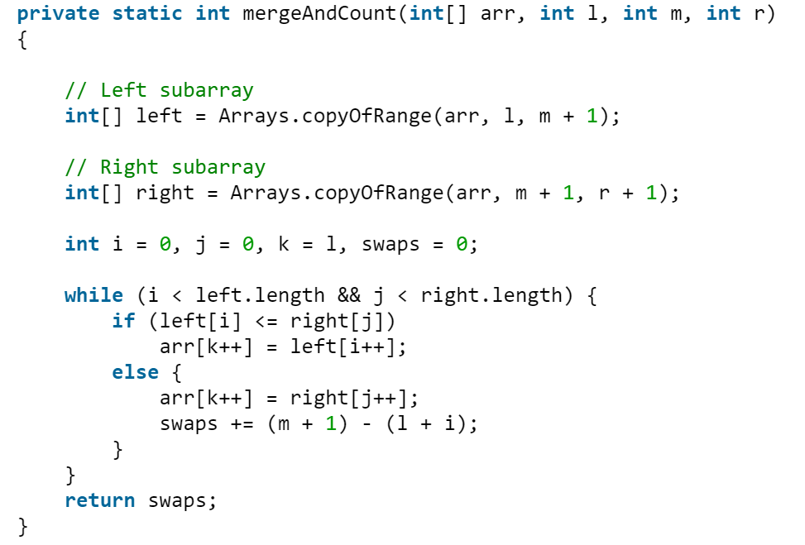
divide
conquer
&
merge

Slide 13
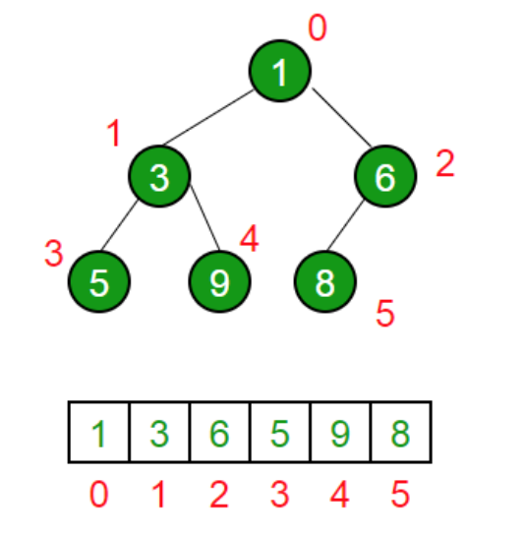
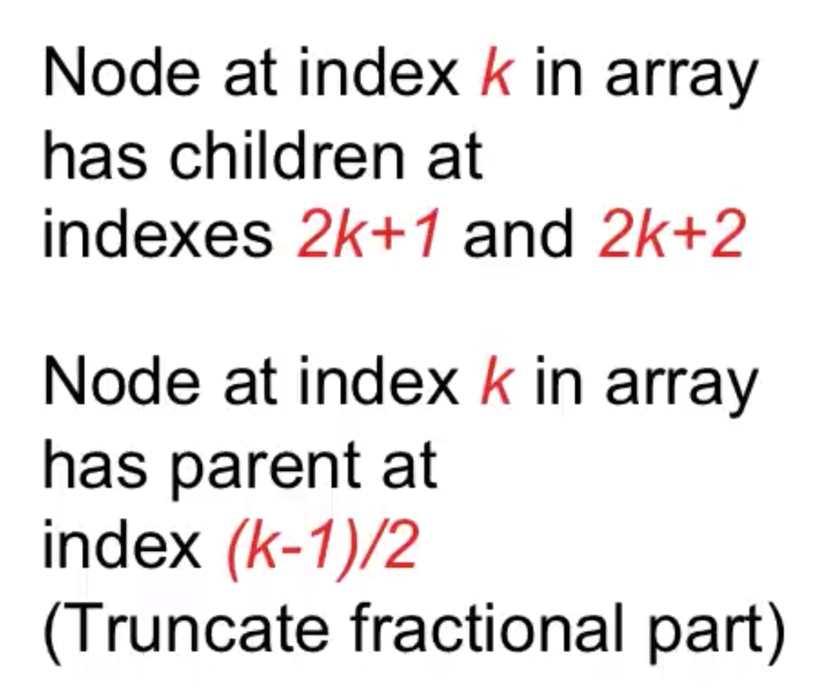
Heapsort - Heap Definition
(Binary) Heap is a special case of balanced binary tree data structure where the root-node key is compared with its children and arranged accordingly.
Min-Heap − Where the value of the root node is less than or equal to either of its children.
Max-Heap − Where the value of the root node is greater than or equal to either of its children.
This is important ->

Slide 14
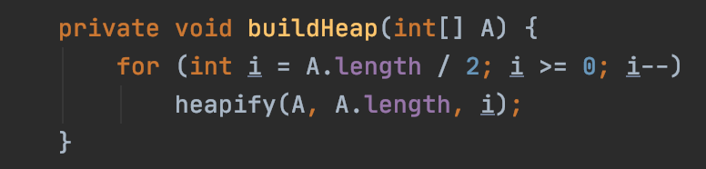
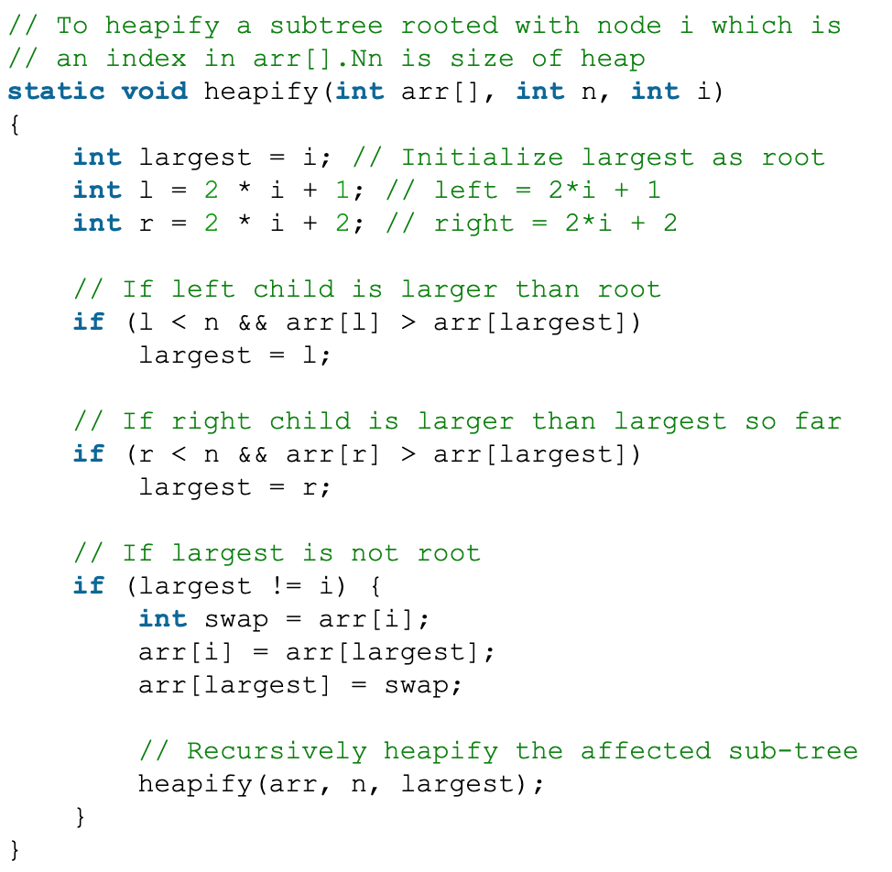
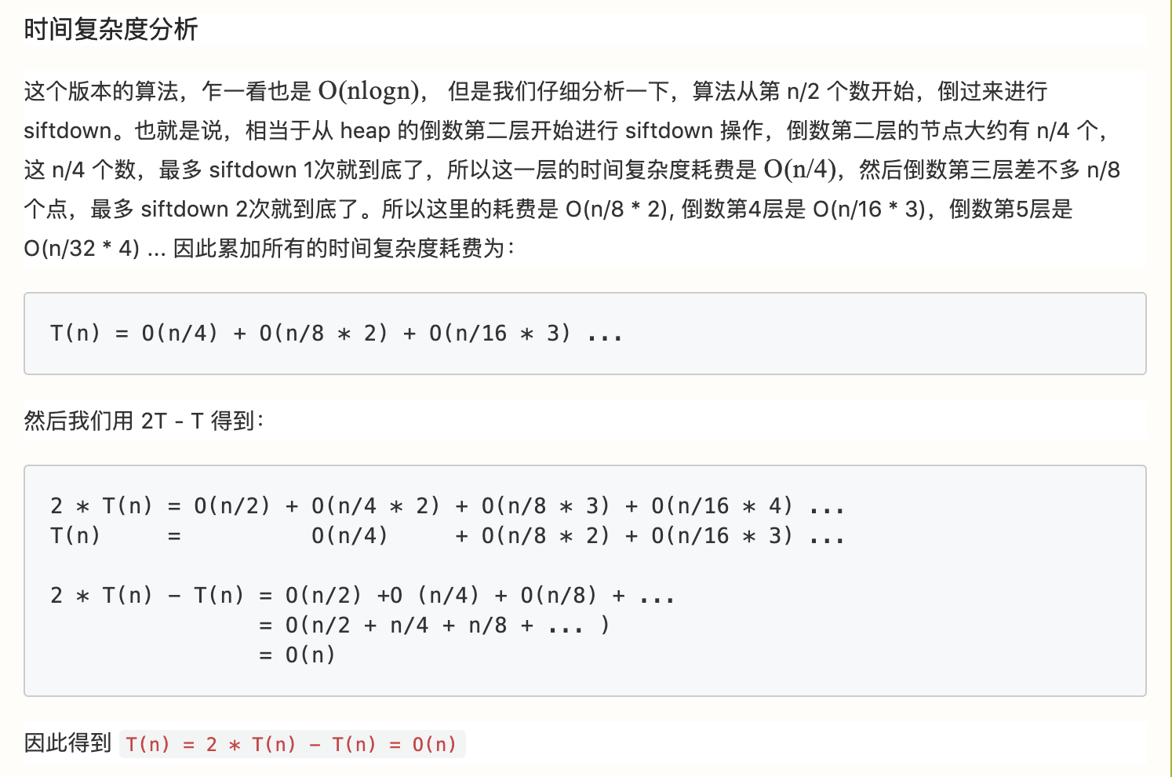
Before heapsort, 让我们先来学习一下Heapify T(n) = O(n)

Slide 15
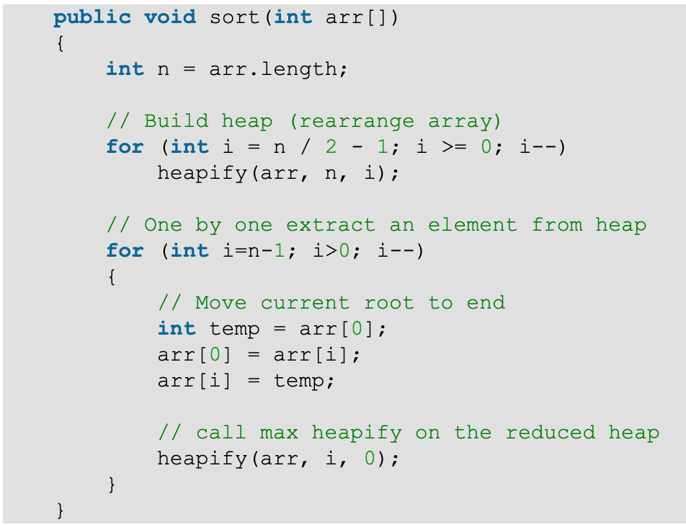
Let’s build an application using heap-- HeapSort
1. Build a max heap from the input data.
2. At this point, the largest item is stored at the root of the heap. Replace it with the last item of the heap followed by reducing the size of heap by 1. Finally, heapify the root of tree.
3. Repeat above steps while size of heap is greater than 1.
时间复杂度一致O(nlogn)

Slide 16
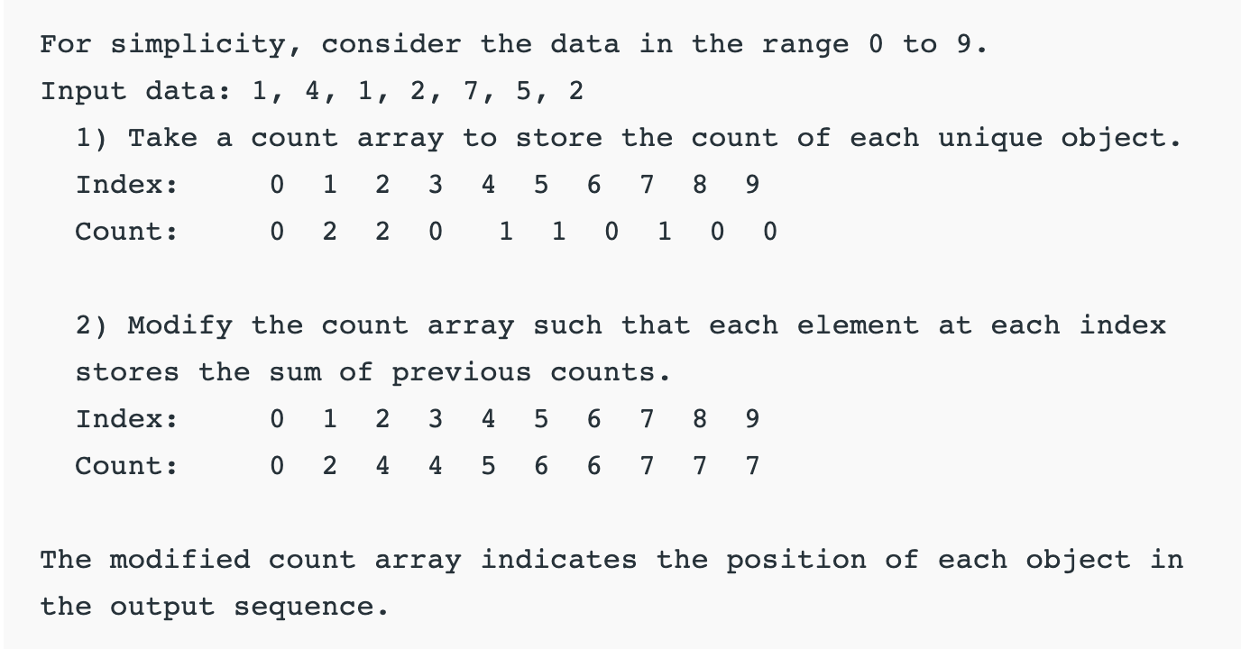
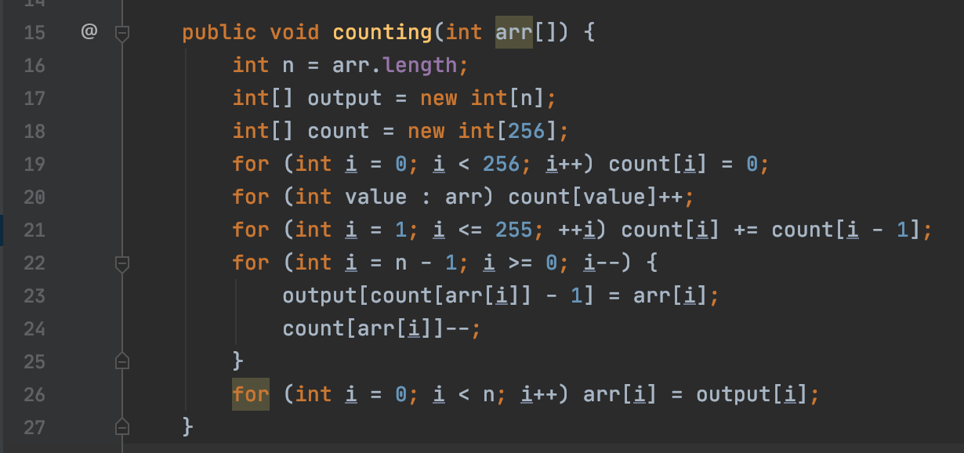
counting sort
Time Complexity: O(n+k)
mapping its value as an index of the auxiliary array.
此版本unstable
To make it better we have to go from right to left when we fill in the output array.
No need to modify the count array when we don't use this feature properly.
另外一种实现方式是手动赋值
int j = 0;
for(int i=0; i<=K; i++) {
int tmp = Aux[i];
// Aux stores which element occurs how many times,
// Add i in sortedA[] according to the number of times i occured in A[]
while(tmp--) {
//cout << Aux[i] << endl;
sortedA[j] = i;
j++;
}
}

Slide 17
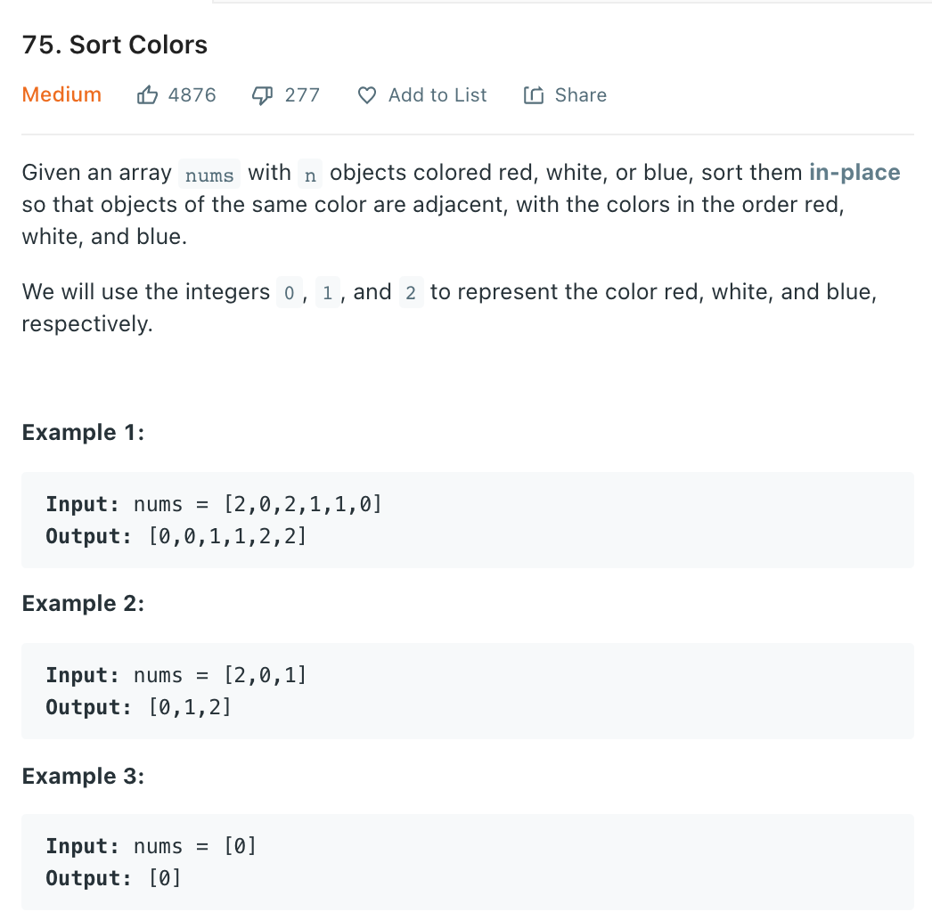
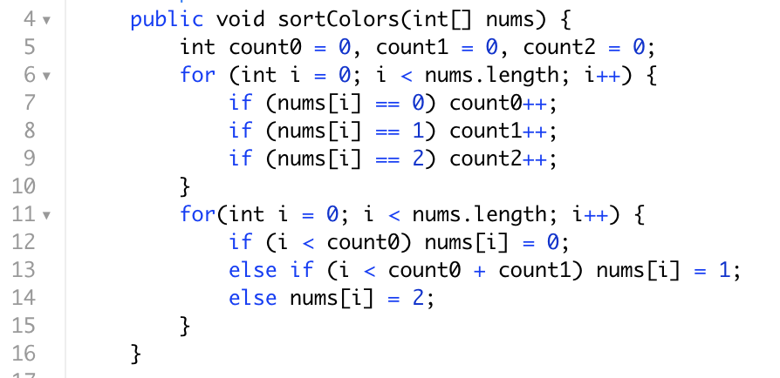
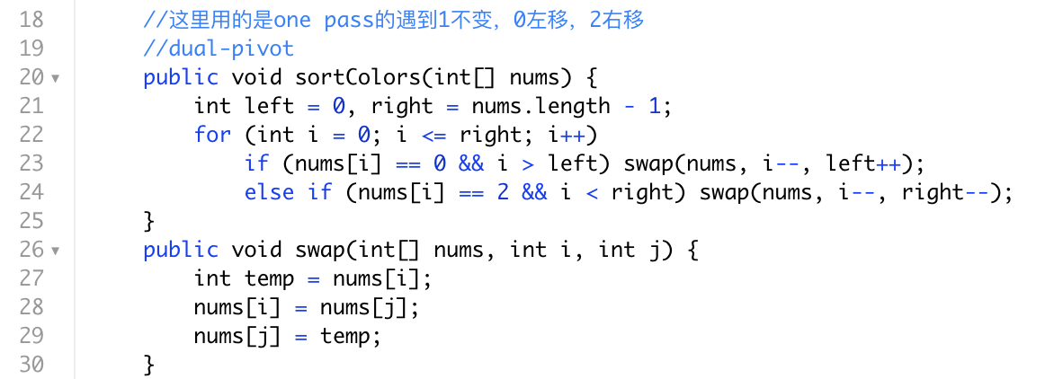
直接counting sort
或者使用双pivot

Slide 18
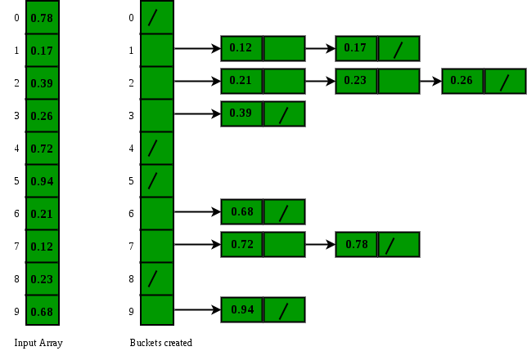
bucket sort
Bucket sort is mainly useful when input is uniformly distributed over a range.
void bucketSort(float[] a,int n) {
for(each floating integer 'x' in n) {
insert x into bucket[n*x];
}
for(each bucket) {
sort(bucket);
}
}
O(n)的时间复杂度

Slide 19
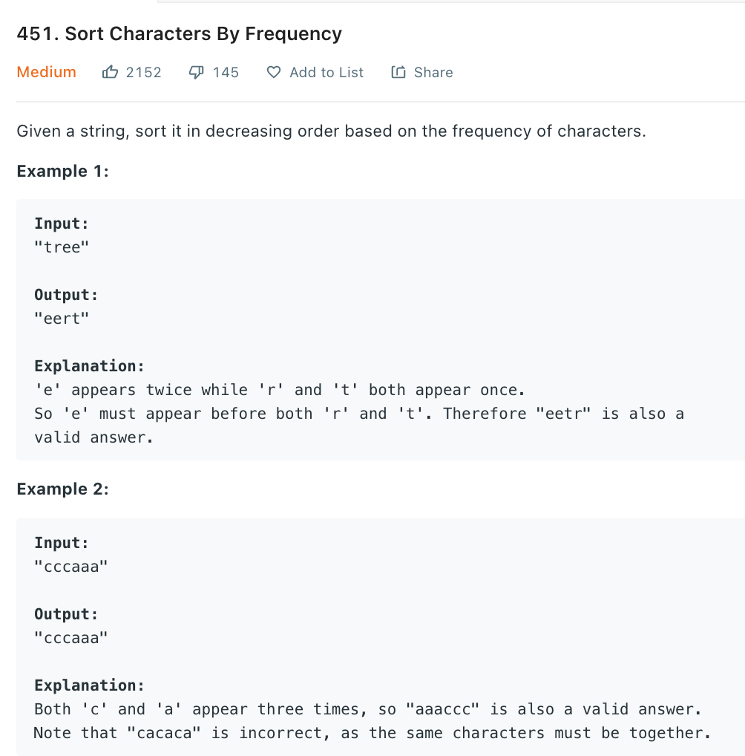
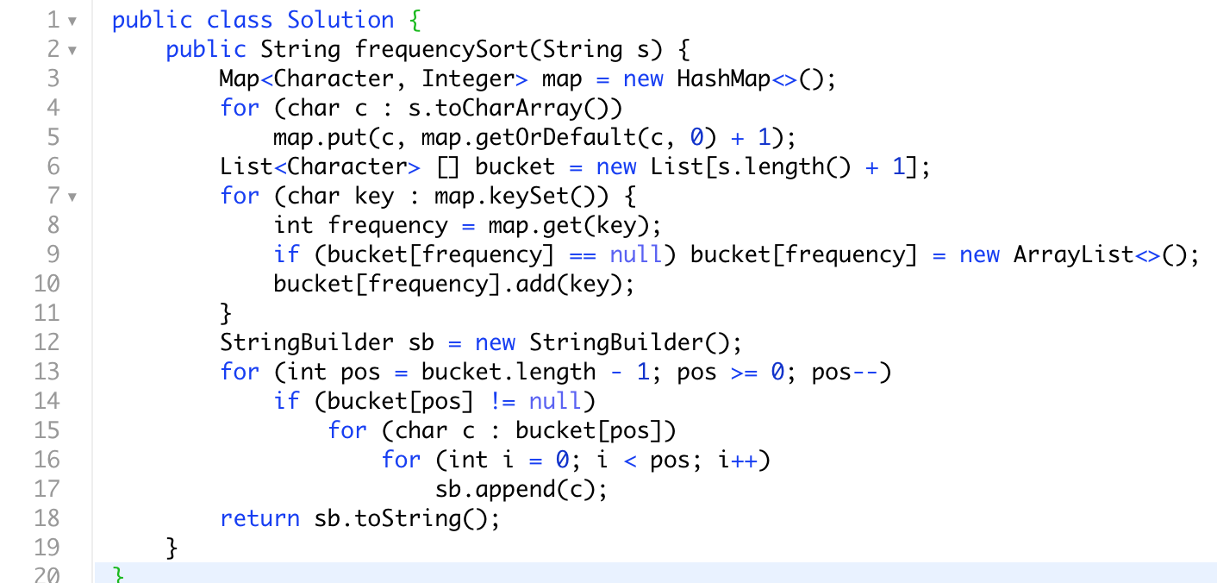
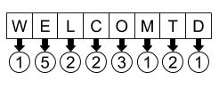
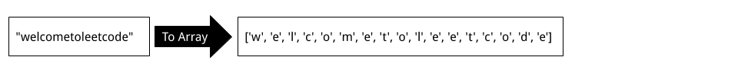
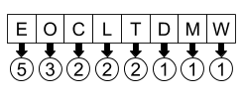

Slide 20
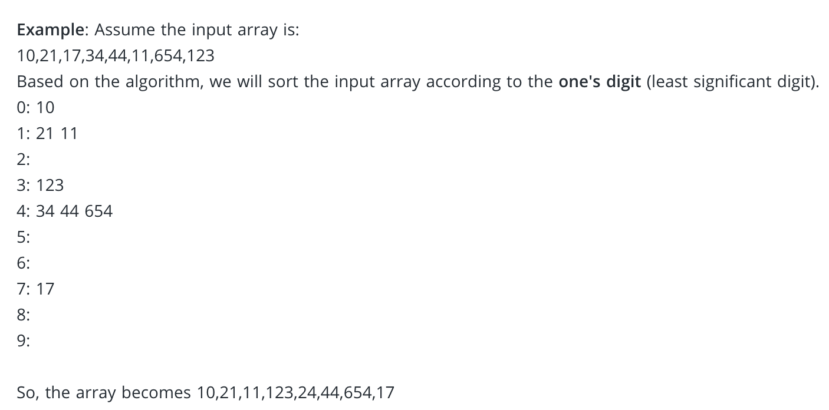
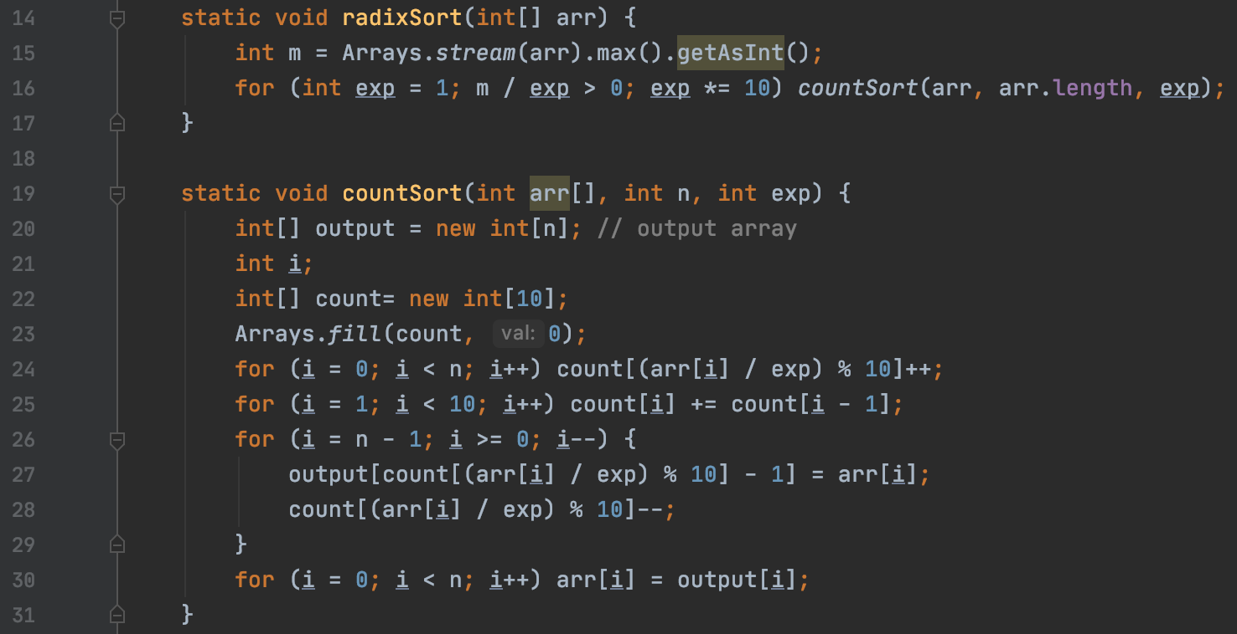
radix sort
For each digit where varies from the least significant digit to the most significant digit of a number
Sort input array using countsort algorithm according to ith digit.
先从最低位比较排序，一位一位退到最高位

Slide 21
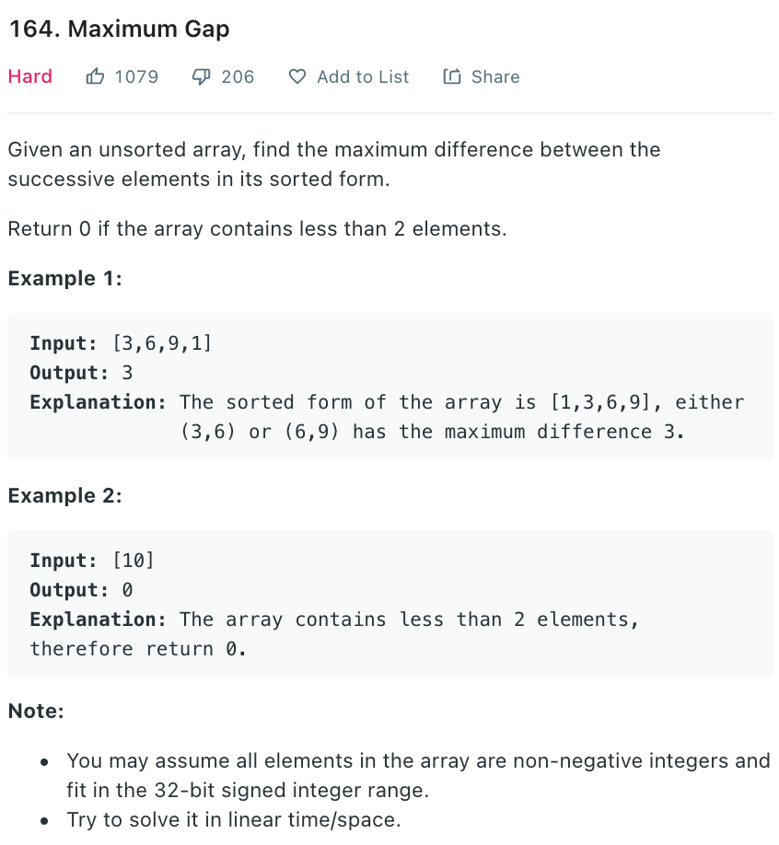
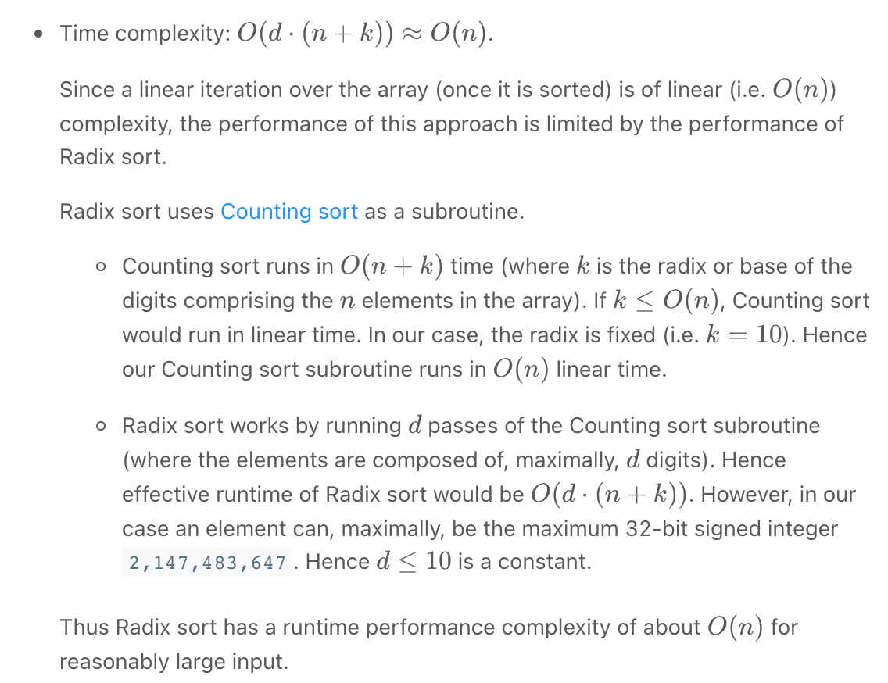
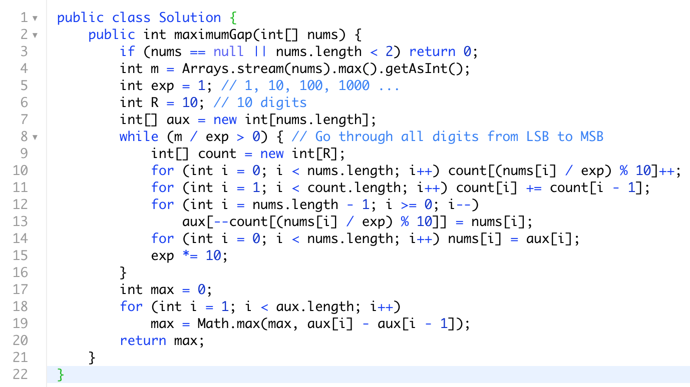

Slide 22
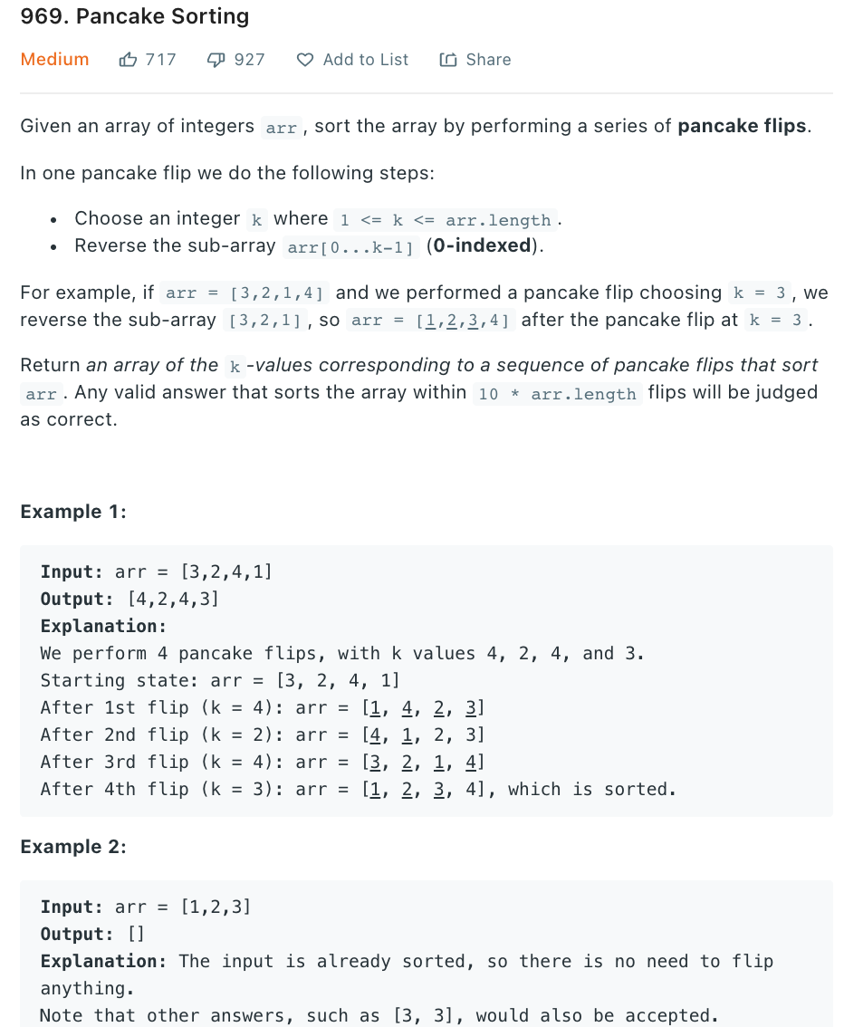
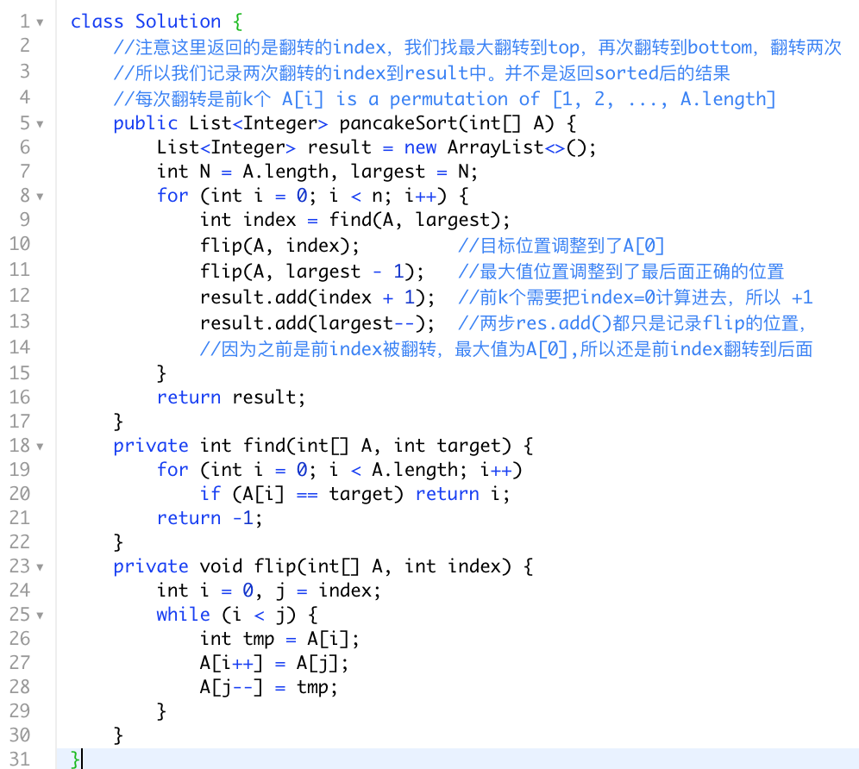
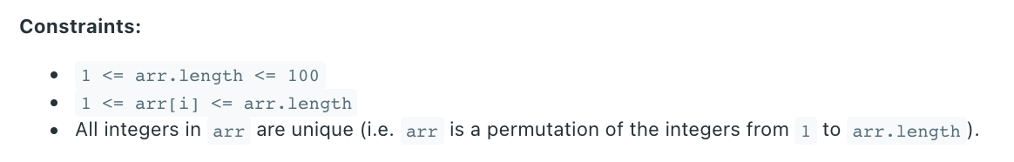
这是特殊的array，值的大小范围有限制

Slide 23
Summary
sorting还经常和二分相关，比如在一个sorted array里面去找target等等
quicksort 又可以quick select, 作为部分sort即可。
quicksort Ave O(nlogn), 为了防止worst case O(n2)我们可以shuffle 或者 random pivot
O(N2) bubble sort, insertion sort, selection sort, shell sort(half gap实现)
O(nlogn) merge sort, heap sort,quick sort
Avg O(N) 有quick select
严格接近O(N), bucket sort(N + k), counting sort, radix sort(NK)

Slide 24
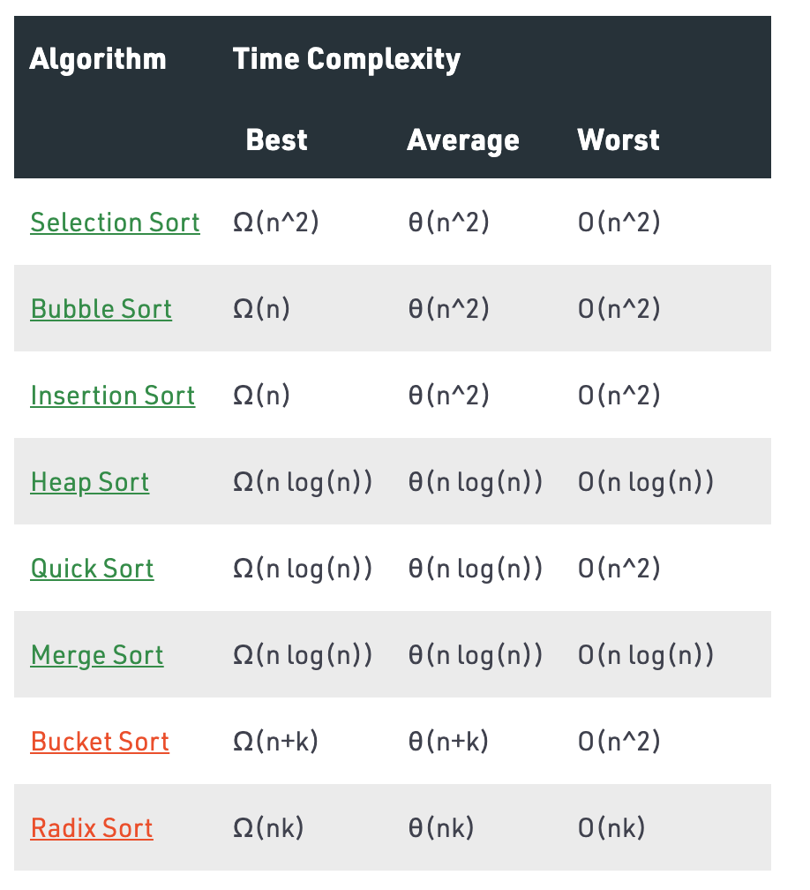
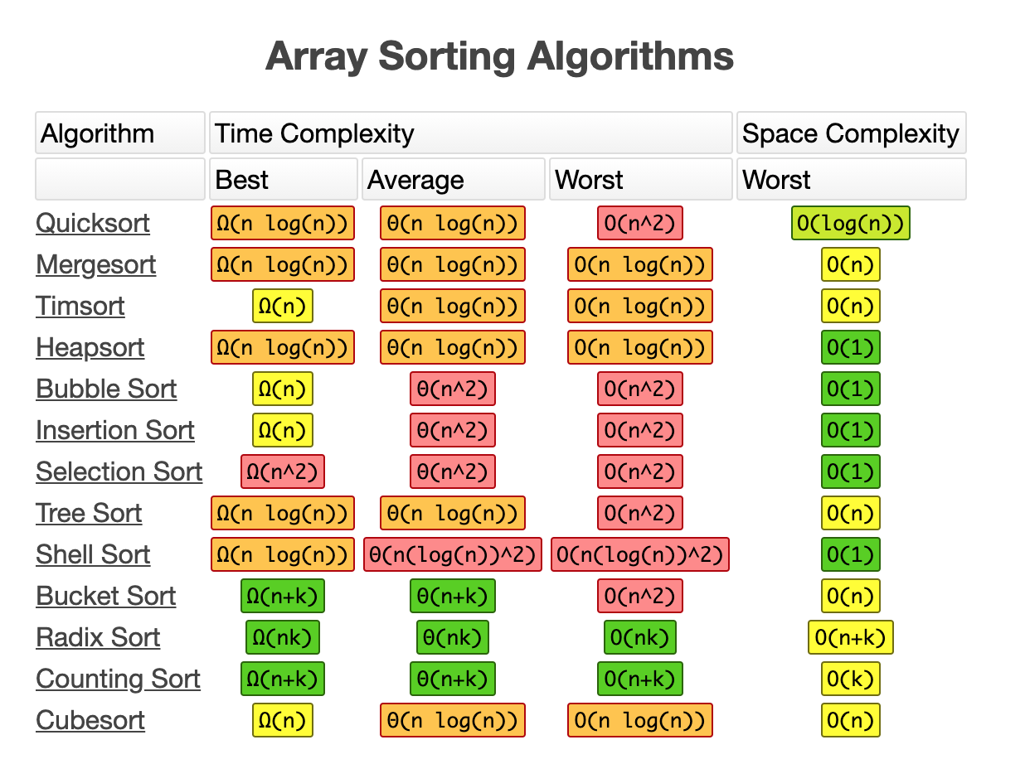

Slide 25


通讯页面
最近小忙，不过我私下和同学一起学习了tree，之后应该会有ppt
Bilibili https://space.bilibili.com/21630984
Youtube 搜索古城算法
https://www.youtube.com/c/古城算法
wechat 回复‘加群’可加群，还有周赛压轴题详解
谢谢大家的支持！请点赞订阅硬币
500订阅会出一期dp总结篇
免费，不要钱，不卖课，不推销，不辅导，公开资料和视频，任何人和你说钱都是骗子！

Slide 26
引用
https://www.hackerearth.com/practice/algorithms/sorting/insertion-sort/tutorial/

